Slide 1
Paper Battery

Slide 2
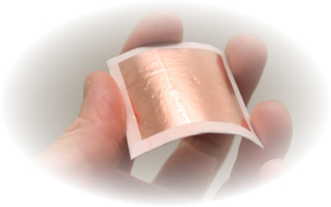
Introduction
A paper battery is a flexible, ultra thin energy storage device made of cellulose (paper) and Carbon nano tubes.
A paper battery can act as a super capacitor and also as a high – energy battery.

Slide 3
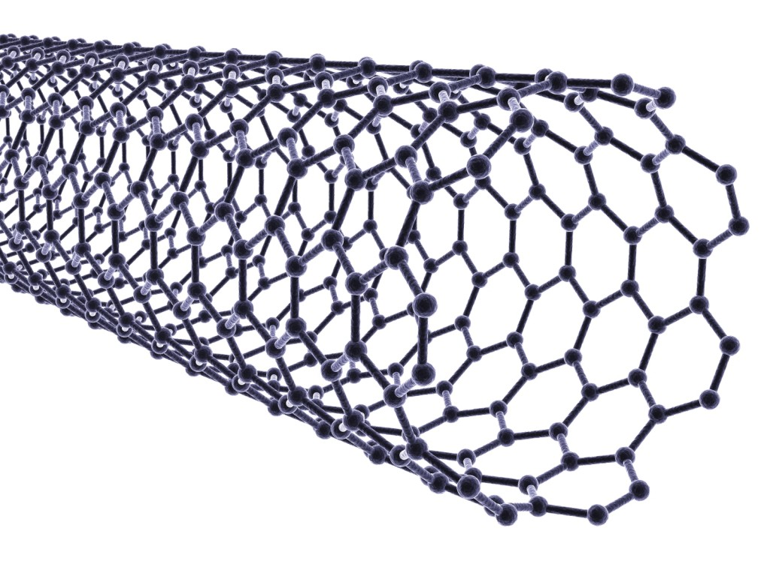
Carbon Nano Tubes (CNT)
Carbon nanotube is an allotrope of carbon. Allotropy is nothing but different structural modifications of an element.
CNTs exhibit extraordinary strength and unique electrical properties, and are efficient thermal conductors.

Slide 4

Development
In August 2007, a research team at Rensselaer Polytechnic Institute led by
Dr. Robert Linhardt, Professor of Biocatalysis and Metabolic Engineering
Pulickel M. Ajayan, professor of materials science and engineering, Omkaram Nalamasu, professor of chemistry with a joint appointment in materials science and engineering) developed the paper battery.
Senior research specialist Victor Pushparaj, along with postdoctoral research associates Shaijumon M. Manikoth, Ashavani Kumar, and Saravanababu Murugesan, were co-authors and lead researchers of the project.
Other co-authors include research associate Lijie Ci and Rensselaer Nanotechnology Center Laboratory Manager Robert Vajtai.

Slide 5
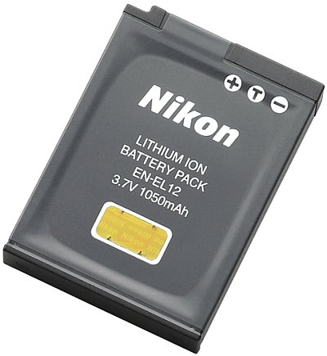
Limitations of Li-ion Battery
Requires protection circuit to maintain voltage and current within safe limits.
Subject to aging, even if not in use - storage in a cool place at 40% charge reduces the aging effect.
Transportation restrictions - shipment of larger quantities may be subject to regulatory control. This restriction does not apply to personal carry-on batteries.
Expensive to manufacture - about 40 percent higher in cost than nickel-cadmium.
Class 9 miscellaneous hazardous material

Slide 6
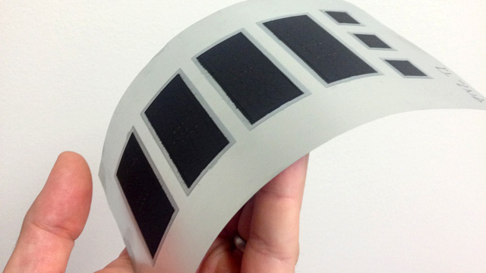
Why To Use Paper Battery?
Ultra-thin size & flexible structure.
Exhibits property of super-capacitor(22F-36F per gram)
Operating temperature(-75 to 100 degree celsius)
provide both long-term, steady power production and bursts of energy.
Cost-effective.

Slide 7
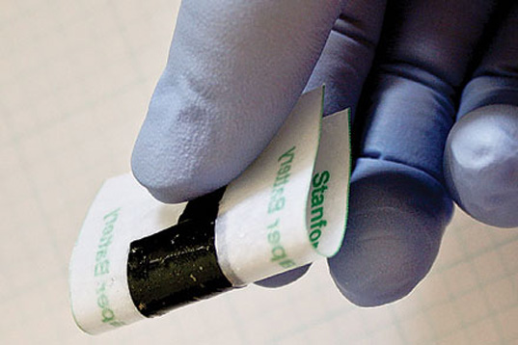
Basic Structure
Cathode: Carbon Nanotube (CNT)
Anode: Lithium metal (Li+)
Electrolyte: All electrolytes (incl. bio electrolytes like blood, sweat and urine)
Separator: Paper (Cellulose)

Slide 8
CONSTRUCTION
CNT thin films were coated onto stainless steel (SS) substrates with a solution based process.
The concentration of CNT is 1.7 mg/mL.
A dried film with a thickness of 2 micrometer was formed after drying the CNT ink on the SS substrate at 80 °C for 5 min.This film is then peeled off from substrate.
These films act as electrodes of paper battery.
one film is pasted to electrolyte LTO (Li4Ti5O12) and the other film is pasted to electrolyte LCO (LiCoO2).
Paper is sandwiched between two electrolytes LTO and LCO with PVDF(poly vinylidene fluoride) acting as glue.

Slide 9
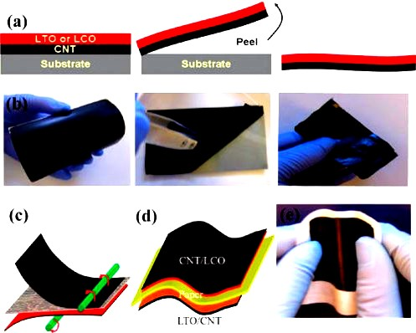

Slide 10
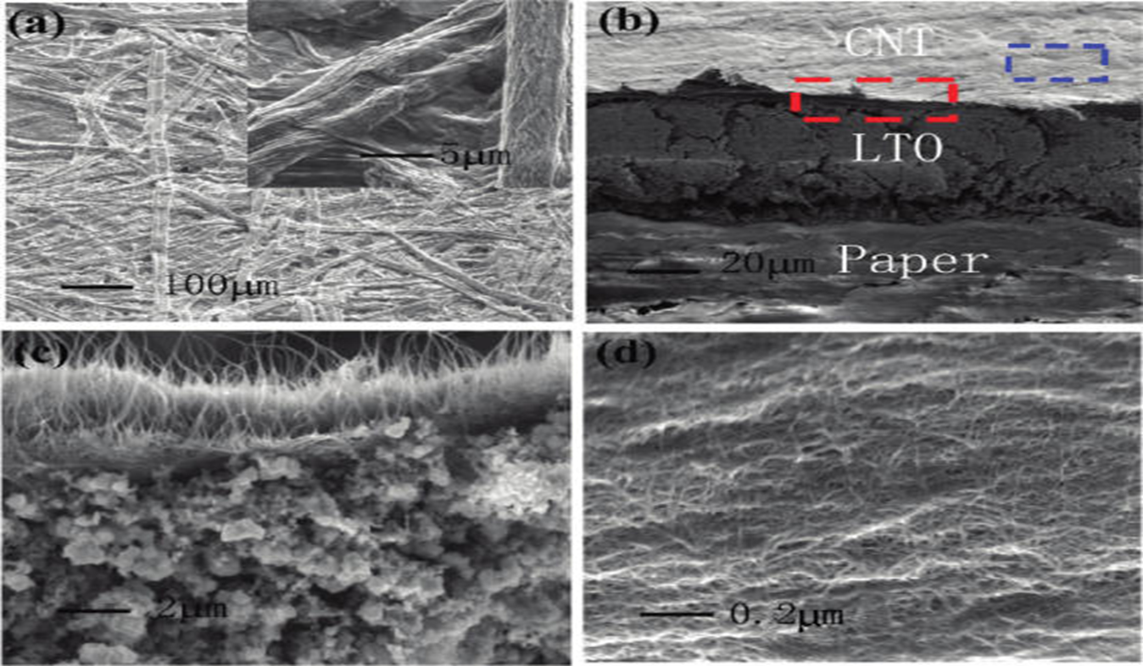
Microscopic View of the Layers

Slide 11
Structure
ELECTRODE
CNT LAYER
LTO LAYER
PAPER LAYER
LCO LAYER
CNT LAYER
ELECTRODE

Slide 12
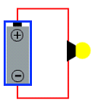
Working
While a conventional battery contains a number of separate components, the paper battery integrates all of the battery components in a single structure, making it more energy efficient.
Traditional Batteries produce electrons through a chemical reaction between electrolyte and metal.
Paper battery produces electrons due to the interaction of electrolytes LTO & LCO.
Electrons collect on the negative terminal of the battery and flow along a connected wire to the positive terminal during discharging.
Electrons must flow from the negative to the positive terminal for the chemical reaction to continue.

Slide 13

Advantages
Biodegradable & Non Toxic
Reusable & Recyclable
Durable
Rechargeable
No Leakage & Overheating
Very Light Weight & Flexible

Slide 14

Limitations & Disadvantages
It would not be logical only to ponder over the miraculous properties and applications of Paper Batteries .Things need to be discussed at the flip side as well.
Following are some of them:
Have Low Shear strength: They can be torn easily.
The Techniques and the Set-ups used in the production of Carbon Nanotubes are very Expensive and very less Efficient. These are:
Arc discharge
Chemical Vapor Deposition (CVD)
Laser Ablation
Electrolysis
When inhaled, their interaction with the Microphages present in the lungs is similar to that with Asbestos fibers, hence may be seriously hazardous to human health.

Slide 15
Applications
Smart cards and tags
Enhanced Printed Circuit Board(PCB)
Electronic games and entertainment devices
Medical Sciences: in Pacemakers for the heart, in Artificial tissues (using Carbon nanotubes)in Cosmetics, Drug-delivery systems, in Biosensors, such as Glucose meters, Sugar meters, etc.
Automobiles and Aircrafts:
• in Hybrid Car batteries
• in Long Air Flights reducing Refueling
• for Light weight guided missiles
• for powering electronic devices in Satellite programs

Slide 16
Conclusion
Standing at a point in the present where there can’t be a day without power, Paper Batteries can provide an altogether path-breaking solution to the same.
Being Biodegradable, Light-weight and Nontoxic, flexible paper batteries have potential adaptability to power the next generation of electronics, medical devices and hybrid vehicles, allowing for radical new designs and medical technologies.
However, commercial applications may be a long way away, because nanotubes are still relatively expensive to fabricate.

Slide 17
References
http://www.eduengg.com/2013/08/paper-battery.html
http://en.wikipedia.org/wiki/Paper_battery#Uses
http://www.durofy.com/paper-batteries-working-construction/

Slide 18
Thank You

